Slide 1
RNN Stock Prediction + Quantization
Michael Zhou
Rongchao Microelectronics, Inc., Shanghai, China

Slide 2
Part 0: Problem Description

Slide 3
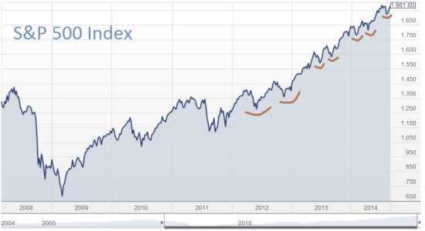
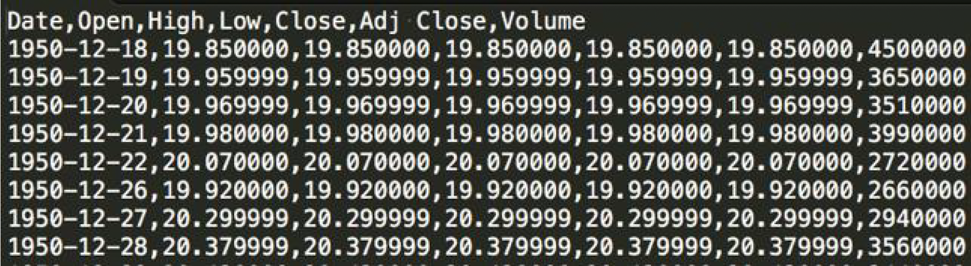

S&P 500 Index Data
Contains daily stock data from 1/3/1950 to 6/23/2017
Only use the ‘close’ price for prediction
Can be downloaded from Yahoo Finance
Want to predict the close prices of the S&P 500 index and deploy it onto an FPGA for real-time analysis

Slide 4
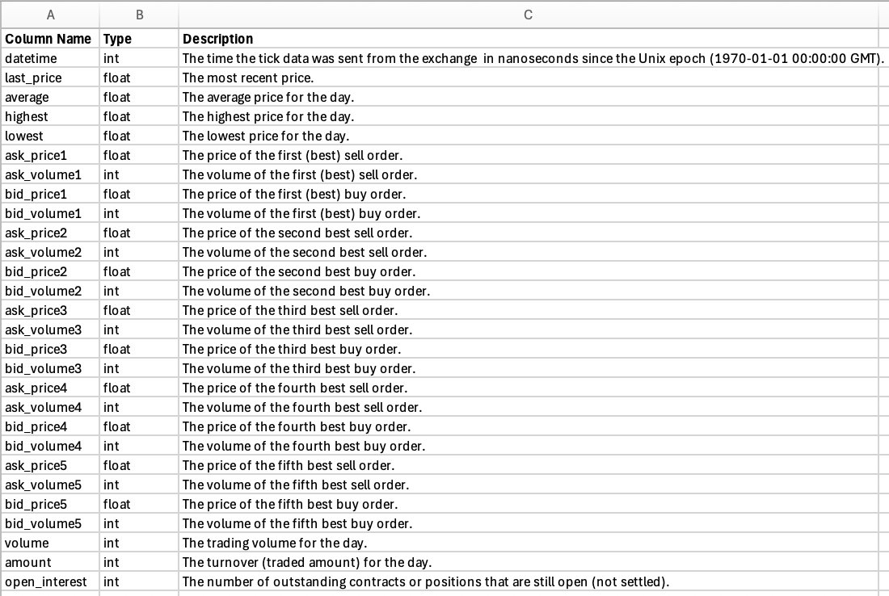
Dataset – Description of Variables

Slide 5
Dataset – Description of Variables
datetime – timestamp of when tick data was recorded
Price variables:
last_price – most recent trading price; direct indicator of current market value
average – average trading price for the day; provides context on overall trading activity & price trends for the day
highest – highest price traded for the day (maximum value)
lowest – lowest price traded for the day (minimum value)
Order book variables:
ask_price1 to ask_price5 – prices of first 5 best-sell orders; reflect sellers’ asking prices (supply side)
ask_volume1 to ask_volume5 – volumes of first 5 best-sell orders; quantity available for each asking price level
bid_price1 to bid_price5 – prices of first 5 best-buy orders; reflect buyers’ bid prices (demand side)
bid_volume1 to bid_volume5 - volumes of first 5 best-sell orders; quantity requested for each bid price level

Slide 6
Dataset – Description of Variables
Volume & Turnover:
volume – total # of shares or contracts traded for the day; measure of market activity & liquidity
amount – total turnover or traded amount ($); complements volume by showing actual financial value of trades
Open Interest:
open_interest - # of outstanding contracts or positions still open and not yet settled; relevant for futures and options markets; level of ongoing market engagement

Slide 7
Dataset – Variable Relationships & Interactions
Price and Order Book:
last_price is influenced by highest bid price (buy orders) and lowest ask price (sell orders) – changes in order book (ask and bid prices/volumes) can determine or respond to changes in last price.
Average, highest, and lowest prices – range and mean prices for the day
Volume and Liquidity:
volume and amount – market liquidity & trading activity; high volume – higher liquidity (smaller bid-ask spreads, more stable prices)
High open_interest - high level of ongoing market interest, indicates market sentiment or future price movements
Market Dynamics:
Interaction between ask & bid prices/volumes – market dynamics
Large volumes at a certain bid price – strong buying interests, prices ⬆︎
Large volumes at a certain ask price – selling pressure, prices ⬇ ︎

Slide 8
Dataset – Variable Relationships & Interactions
Price movements – market direction & momentum determined by how last_price changes in relation to bid & ask prices
Volume analysis – high trading volume at specific price levels (ask or bid) indicate support or resistance levels
Order book depth – distribution of ask & bid prices/volumes (order book depth) provides information on market liquidity & potential price volatility
Open interest trends – changes in open interest can be used to gauge market sentiment & potential future price movements, especially in derivative markets

Slide 9
Part 1: Preprocessing
Main Contract, Data Cleaning

Slide 10
High-Frequency Activity (Main Contract Signed)
Signing of ”main contract” – transition from low-frequency to high-frequency trading activity

Slide 11
Part 2: Machine Learning Workflow
Data Preparation, Normalization, Models, Evaluation

Slide 12
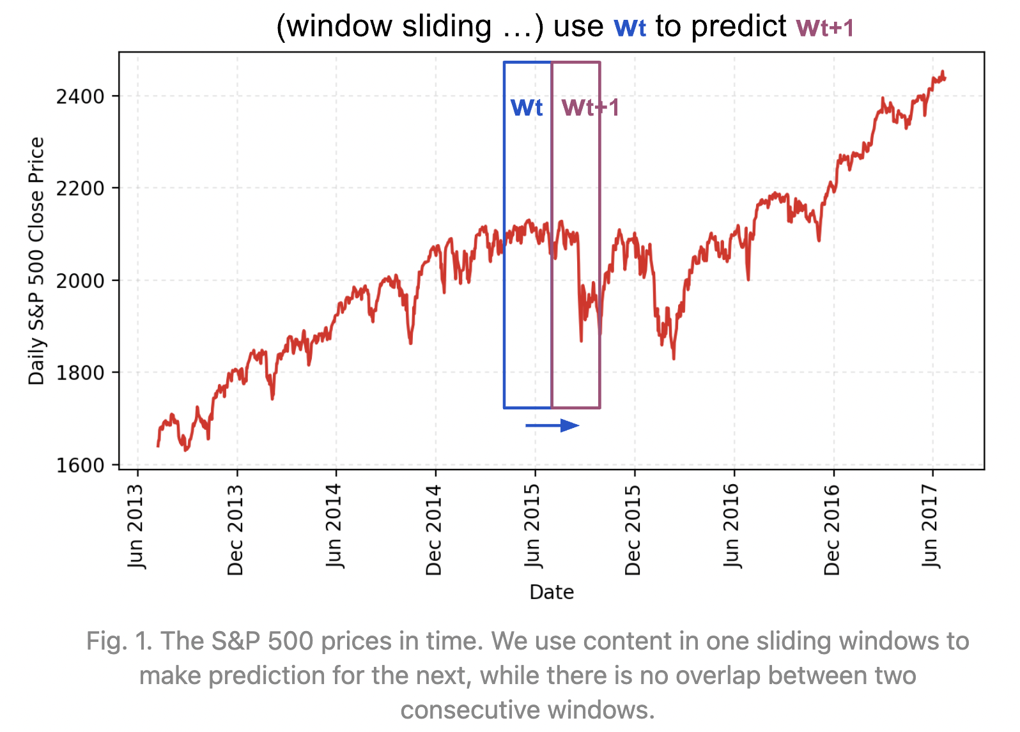
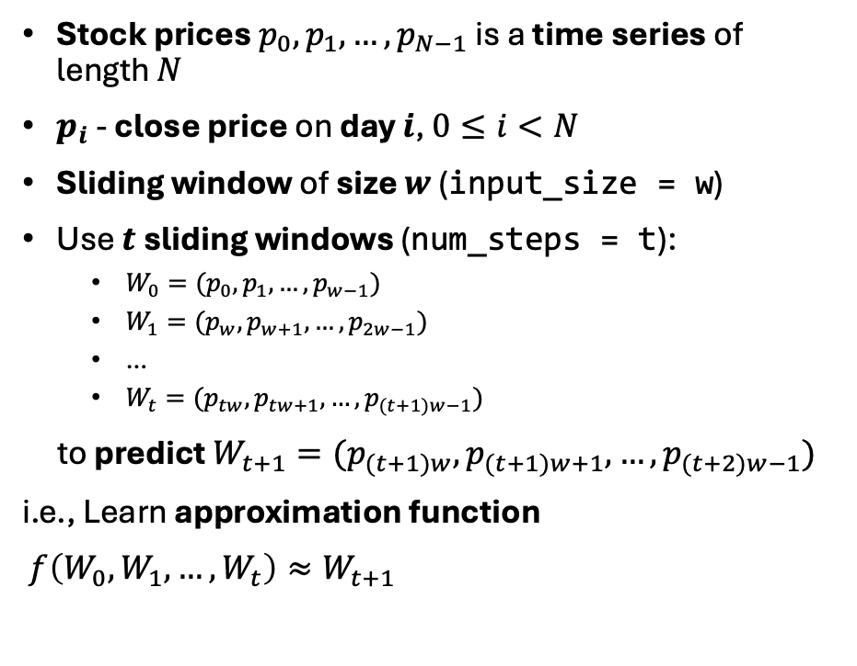
Data Preparation
Stock prices $p_{0},p_{1}, …, p_{N−1}$ is a time series of length $N$
$p_{i}$ - close price on day $i$, $0≤i<N$
Sliding window of size $w$ (input_size = w)
Use $t$ sliding windows (num_steps = t):
$W_{0}=(p_{0}, p_{1},…, p_{w−1})$
$W_{1}=(p_{w}, p_{w+1},…, p_{2w−1})$
…
$W_{t}=(p_{tw}, p_{tw+1},…, p_{(t+1)w−1})$
to predict $W_{t+1}=(p_{(t+1)w}, p_{(t+1)w+1},…, p_{(t+2)w−1})$
i.e., Learn approximation function
$f\left(W_{0}, W_{1},…, W_{t}\right)≈W_{t+1}$

Slide 13
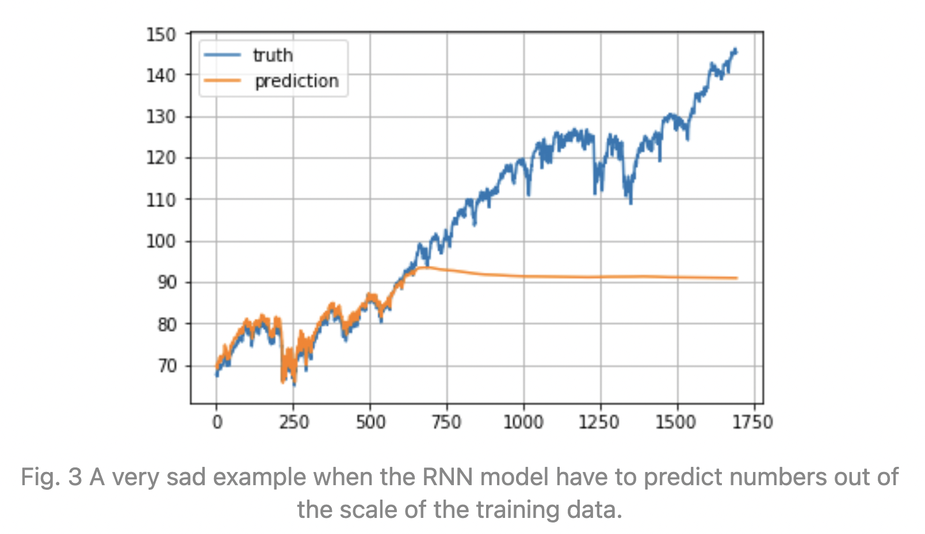
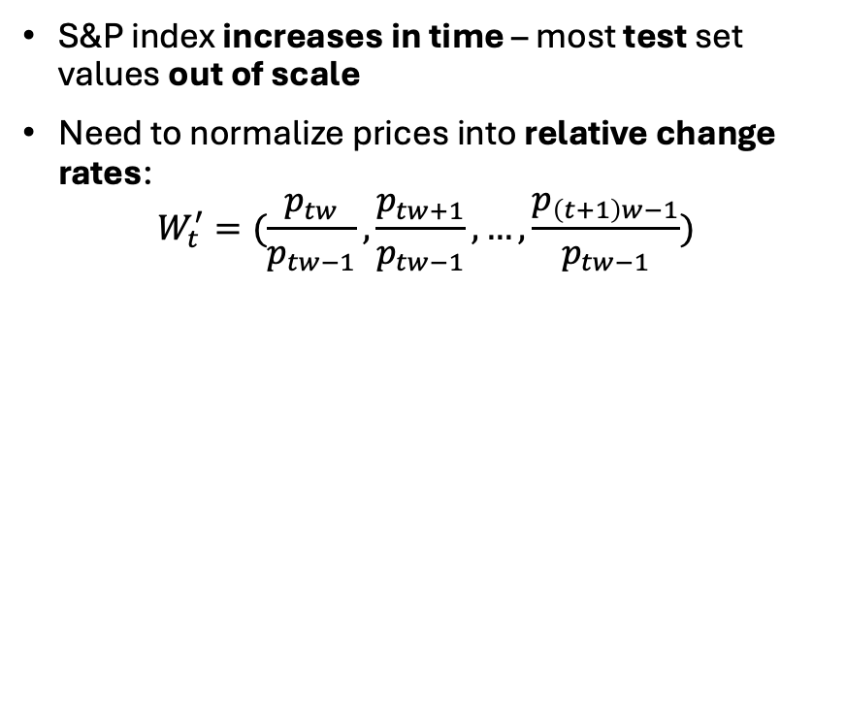
Normalization
S&P index increases in time – most test set values out of scale
Need to normalize prices into relative change rates:
$$W_{t}^{′}=(\frac{p_{tw}}{p_{tw−1}},\frac{p_{tw+1}}{p_{tw−1}},…,\frac{p_{\left(t+1\right)w−1}}{p_{tw−1}})$$

Slide 14
Train/Val/Test Split
Train/Val/Test: 80/10/10
train
val
test
80%
10%
10%

Slide 15
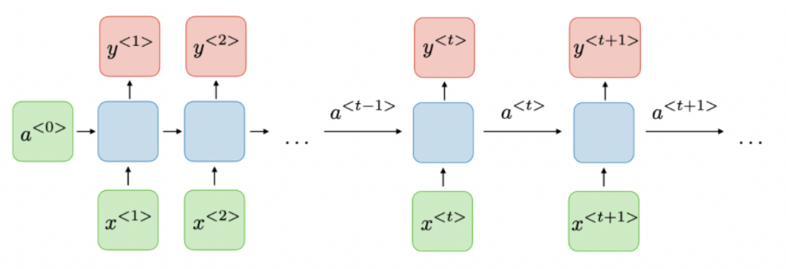
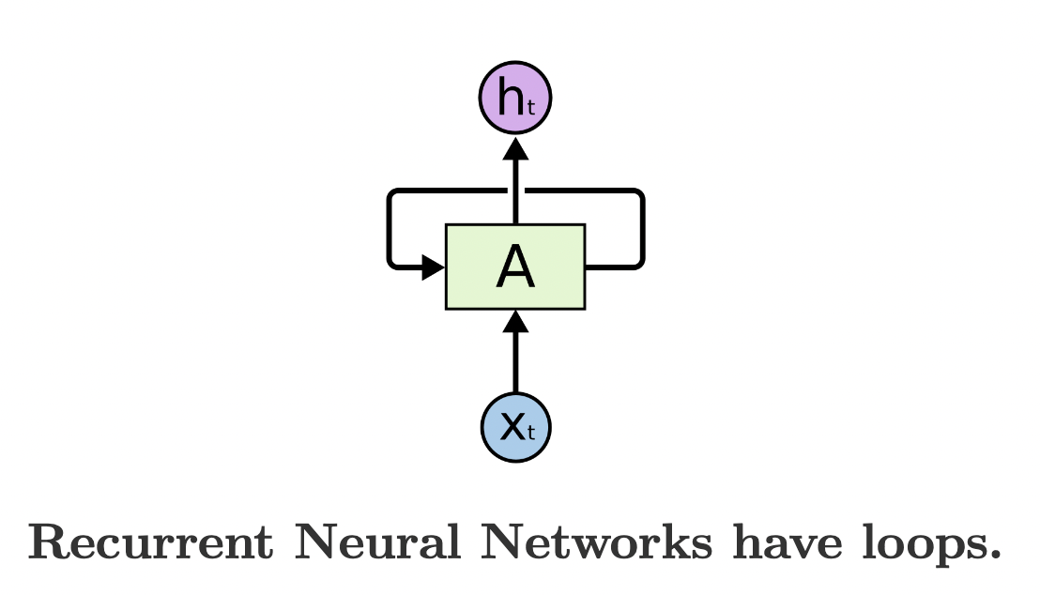
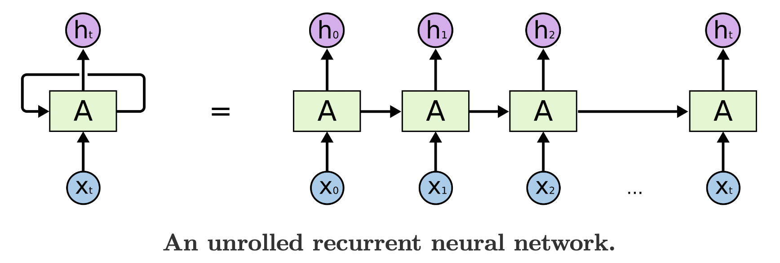
Recurrent Neural Network (RNN)
Previous outputs used as inputs, along with hidden states
Models sequential data and temporal dependencies
Contains self-loops (allows information to be passed between time steps)
Used in speech recognition, language modeling, translation, image captioning, etc.

Slide 16
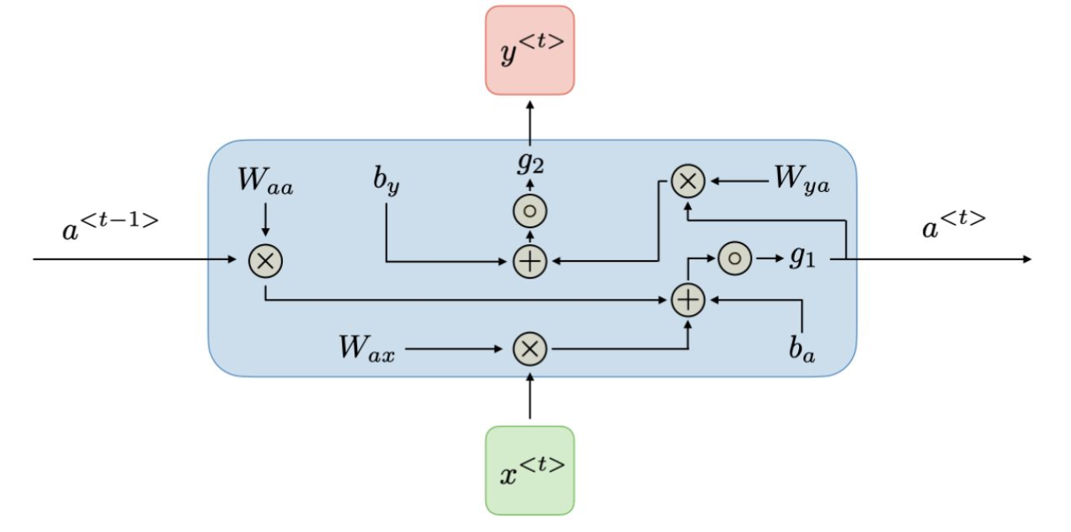
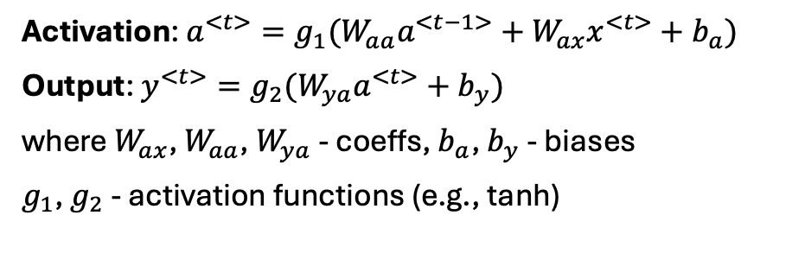
Recurrent Neural Network (RNN)
Activation: $a^{<t>}=g_{1}(W_{aa}a^{<t−1>}+W_{ax}x^{<t>}+b_{a})$
Output: $y^{<t>}=g_{2}(W_{ya}a^{<t>}+b_{y})$
where $W_{ax}$, $W_{aa}$, $W_{ya}$ - coeffs, $b_{a}$, $b_{y}$ - biases
$g_{1}$, $g_{2}$ - activation functions (e.g., tanh)

Slide 17
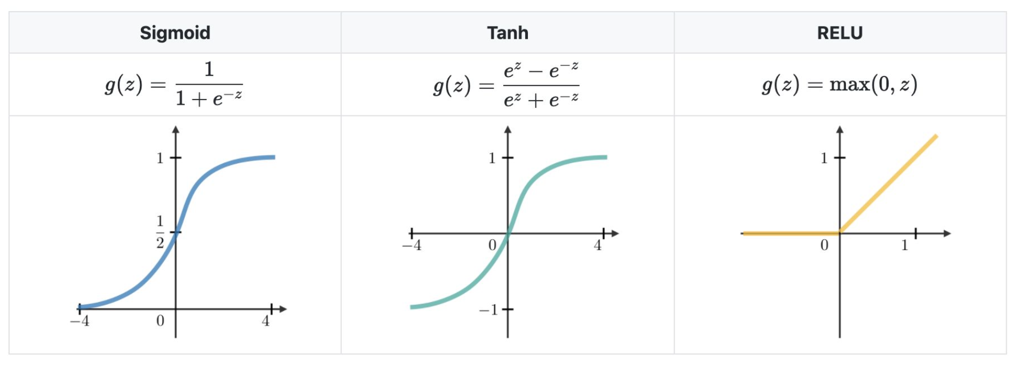
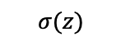
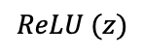
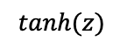
Recurrent Neural Network (RNN) – Activation Functions
$$σ(z)$$
$tanh(z)$
$$ReLU (z)$$

Slide 18
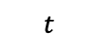
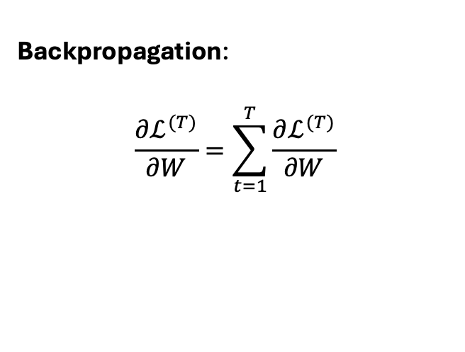
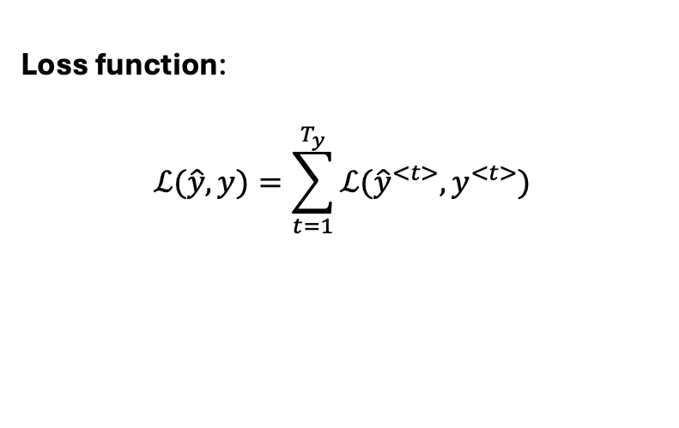
Recurrent Neural Network (RNN) - Training
Loss function:
$$ℒ(\hat{y},y)=\sum_{t=1}^{T_{y}}{ℒ({\hat{y}}^{<t>},y^{<t>})}$$
Backpropagation:
$$\frac{∂ℒ^{(T)}}{∂W}=\sum_{t=1}^{T}{\frac{∂ℒ^{(T)}}{∂W}}$$
______
$$t$$
e.g., MSE, cross-entropy, etc.

Slide 19
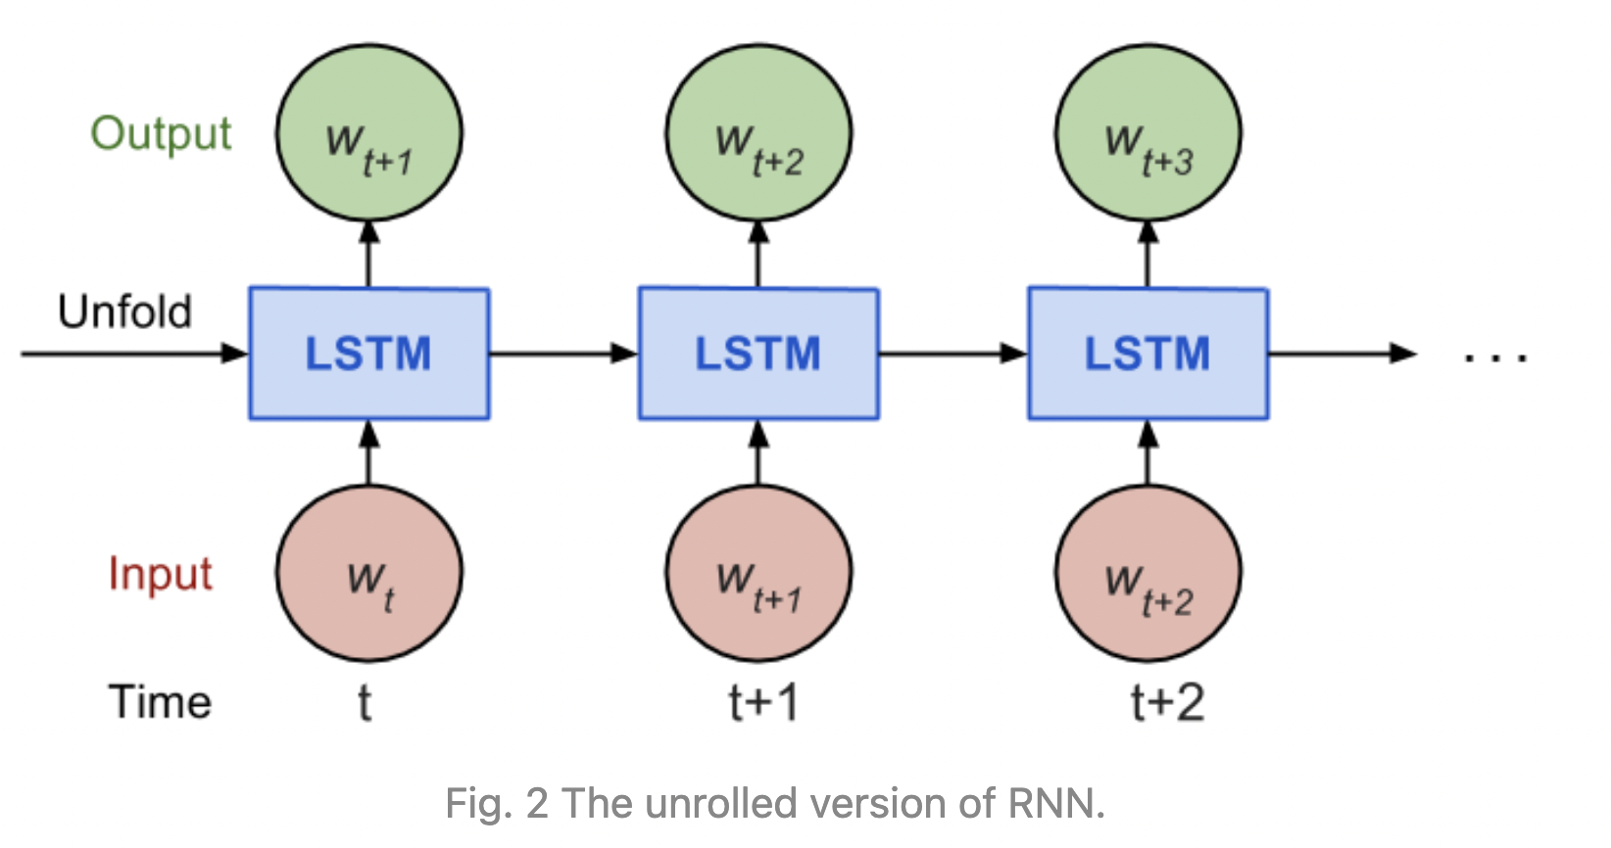
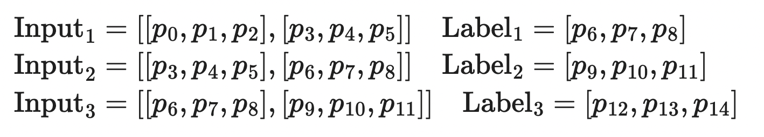
Backpropagation: “Unrolled” RNN
No need to do backpropagation too far back
Output of RNN depends on arbitrarily distant inputs - very difficult for backpropagation
Create “unrolled” version of RNN – fixed number of inputs & outputs (num_steps)
Train model on “finite approximation” of RNN – perform backward pass after each input block
First few training examples for input_size=3, num_steps=2

Slide 20
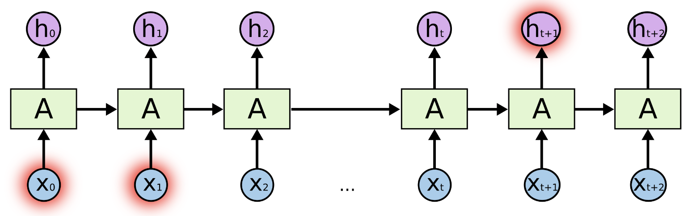
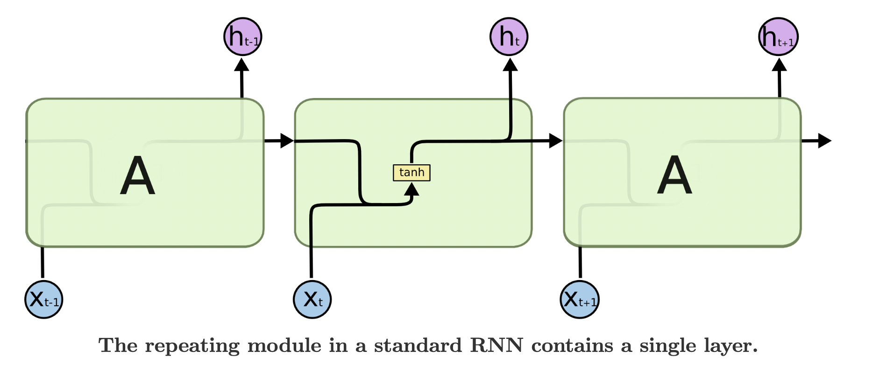


Recurrent Neural Network (RNN) - Limitations
Long term dependencies
RNN can learn past information for small gaps (e.g., “The clouds are in the sky”) due to simplistic (single-layer) structure
As gap grows, RNN becomes unable to connect information (e.g., “I grew up in France...I speak French”)
Vanishing/Exploding gradients
Multiplicative gradient descent – gradients exponentially decreasing or increasing with respect to number of layers
Vanishing - more difficult to update weights and learn from past data
Exploding – instability in training
Traditional RNNs: Difficult to connect information for large gaps

Slide 21
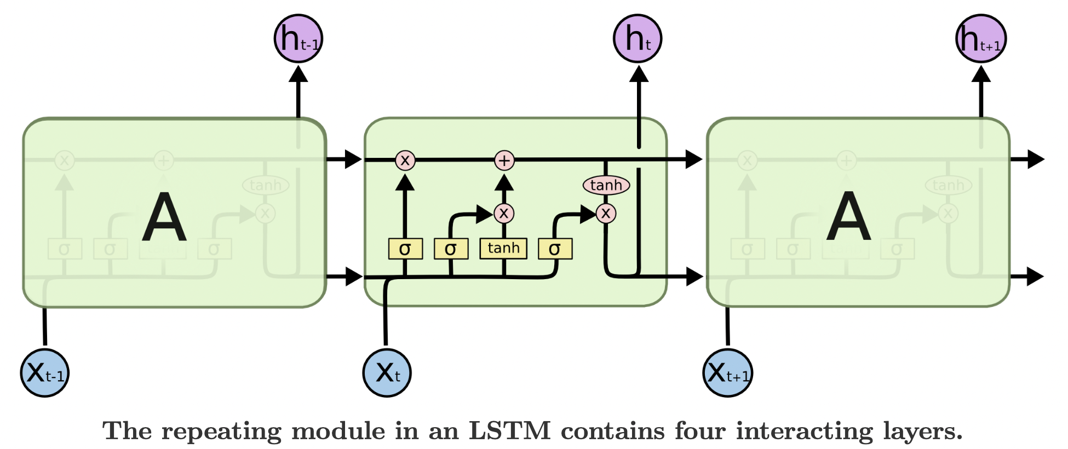
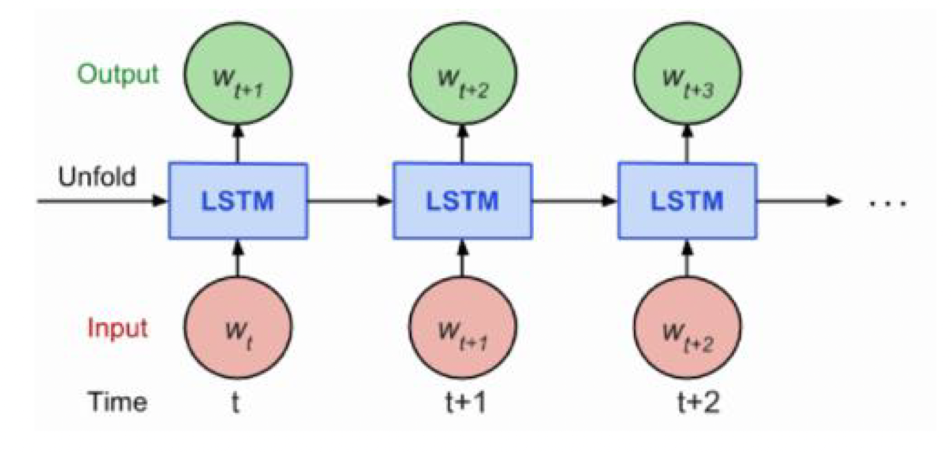
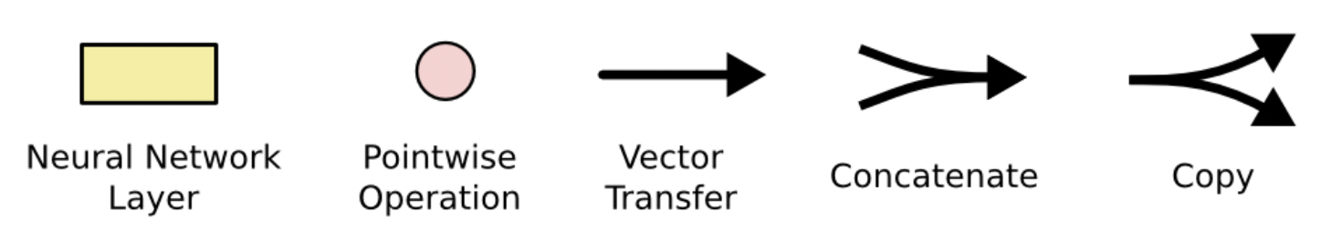
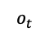
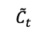
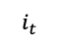
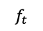
Long Short Term Memory (LSTM)
Designed to avoid long-term dependency problems in traditional RNNs
Contains four interacting layers (instead of one in traditional RNNs)
$$f_{t}$$
$$i_{t}$$
$$o_{t}$$
$${\tilde{C}}_{t}$$

Slide 22
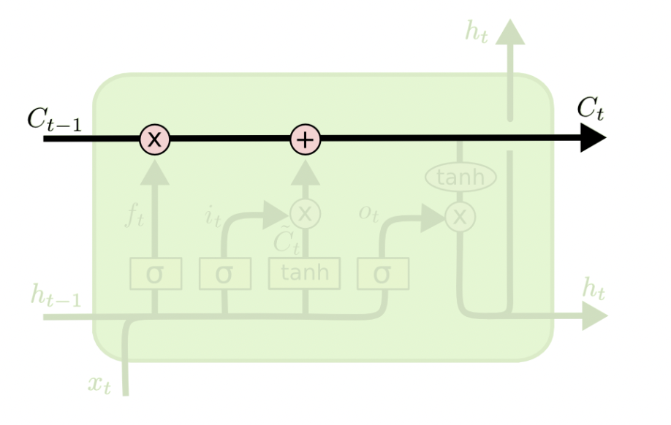
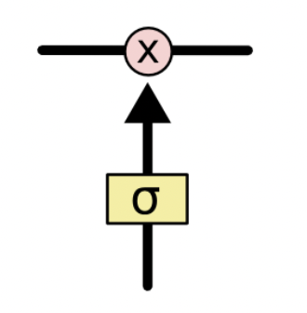
Long Short Term Memory (LSTM) - Gates
Cell state – send information down with only minor linear interactions (like a conveyor belt)
Gates – can add or remove information to cell state to optionally let information through
3 gates:
Forget gate – what relevant information can be removed from current step
Input gate – what relevant information can be added from the current step
Output gate – finalize the next hidden state
Cell State
Gate

Slide 23
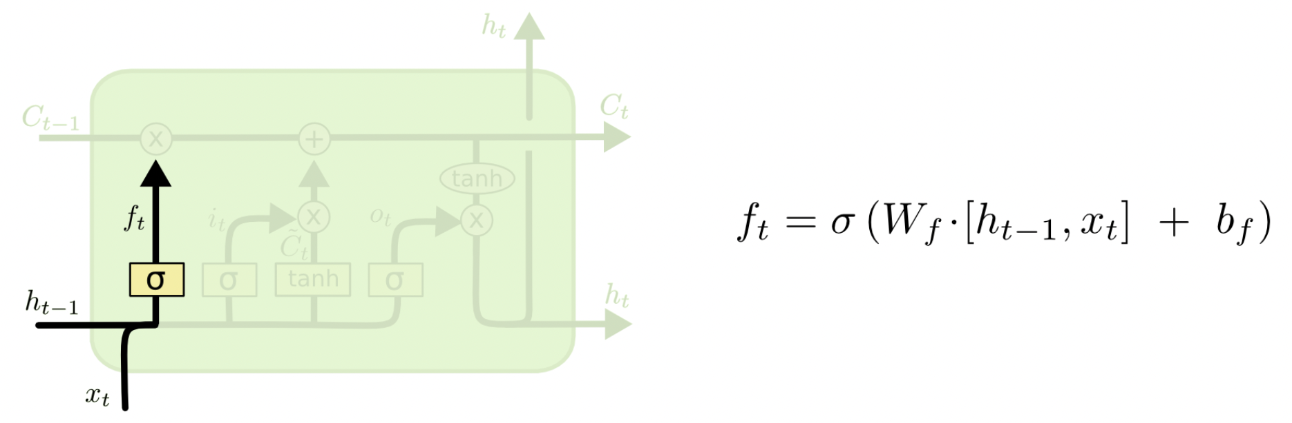
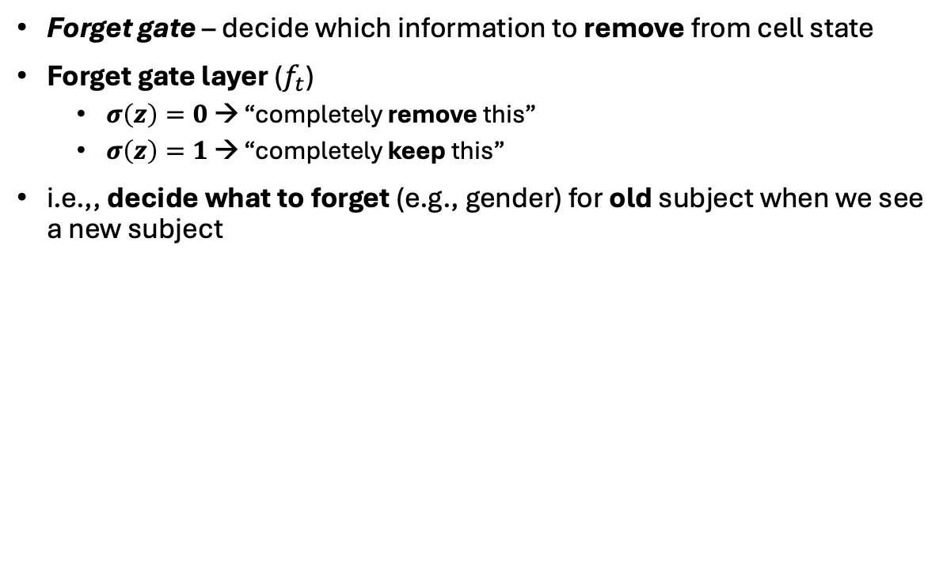
Long Short Term Memory (LSTM) – Forget Gate
Step 1: Decide which information to remove from cell state
Forget gate – decide which information to remove from cell state
Forget gate layer ($f_{t}$)
$σ\left(z\right)=0$ → “completely remove this”
$σ\left(z\right)=1$ → “completely keep this”
i.e.,, decide what to forget (e.g., gender) for old subject when we see a new subject

Slide 24
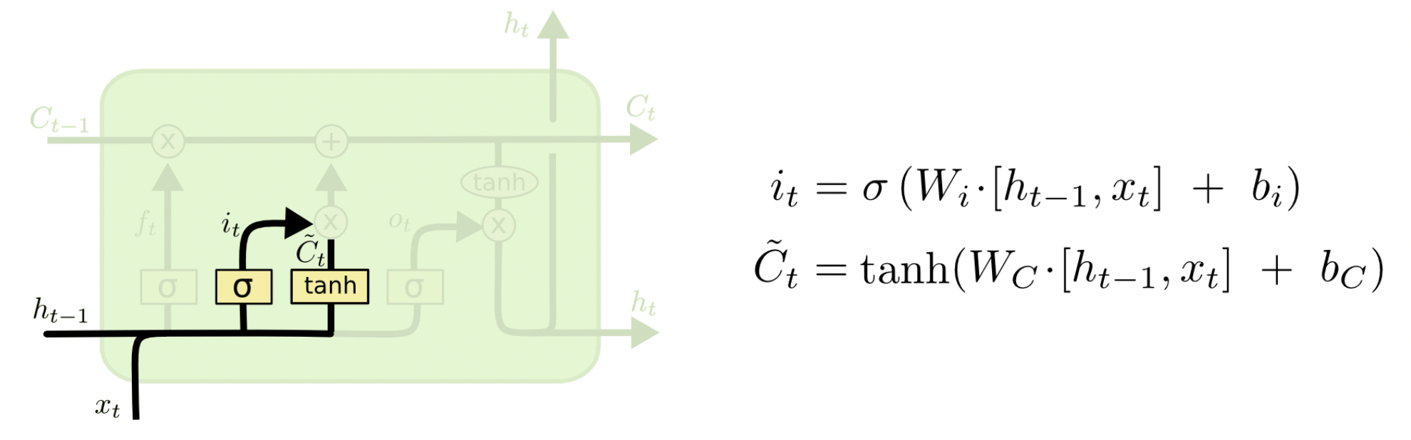
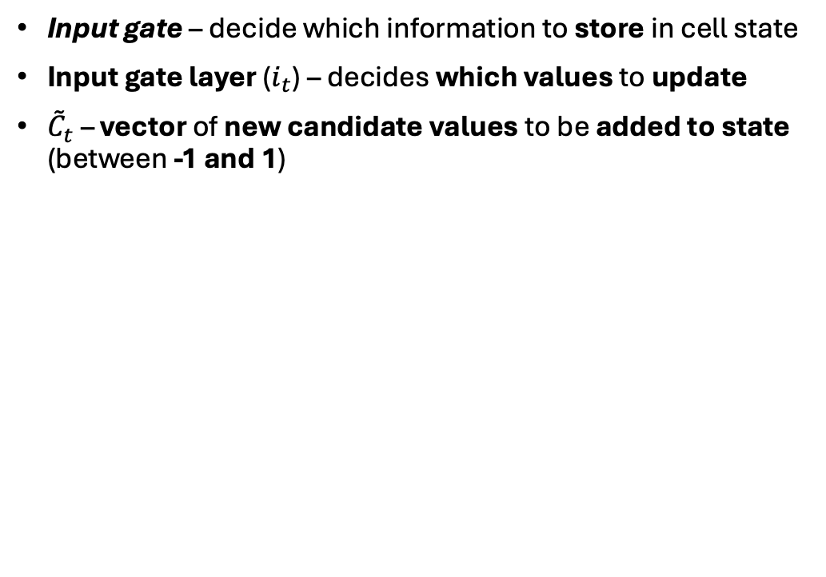
Long Short Term Memory (LSTM) – Input Gate
Step 2: Decide which information to store from cell state
Input gate – decide which information to store in cell state
Input gate layer ($i_{t}$) – decides which values to update
${\tilde{C}}_{t}$ – vector of new candidate values to be added to state (between -1 and 1)

Slide 25
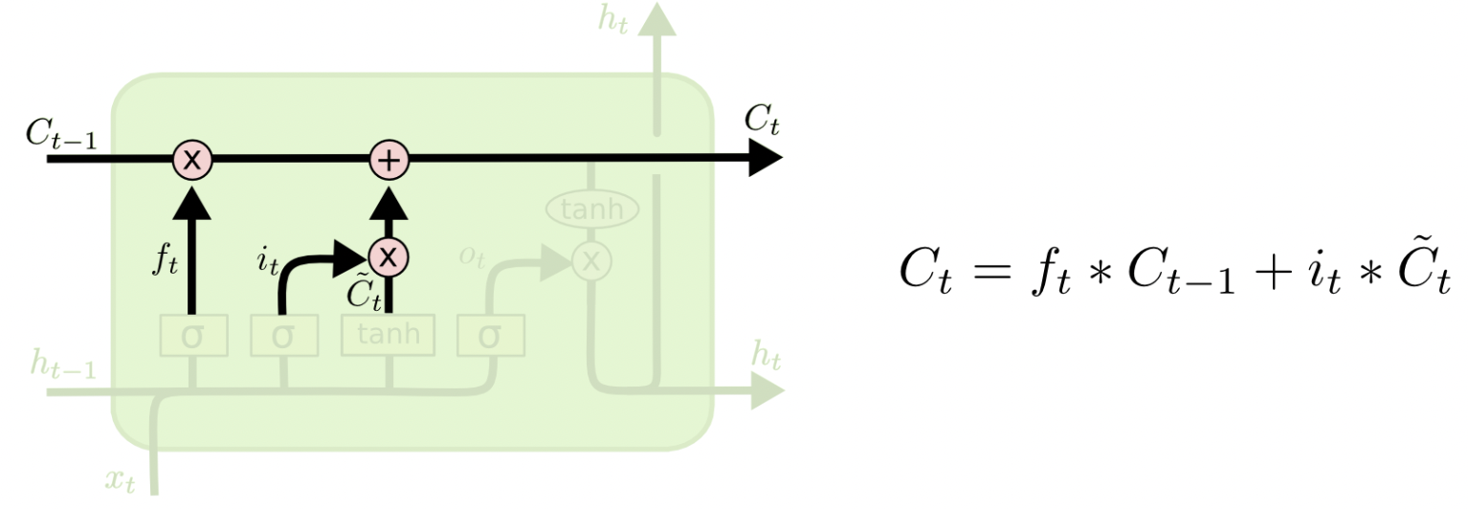
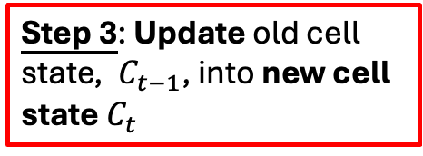
Long Short Term Memory (LSTM) – Input Gate
Step 3: Update old cell state, $C_{t−1}$, into new cell state $C_{t}$
i.e., drop old information and add new information
forget
new info

Slide 26
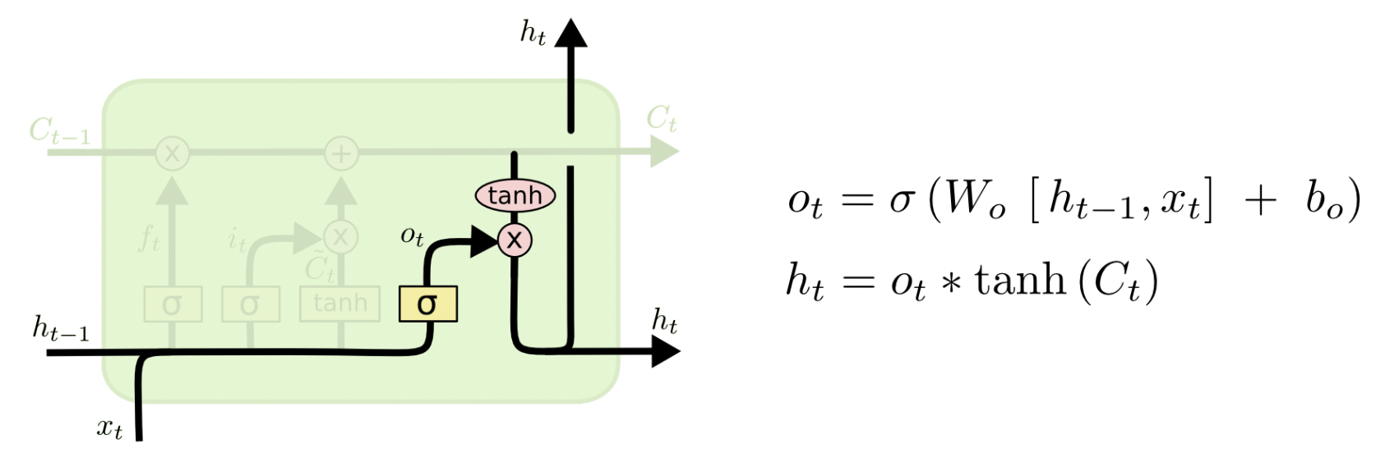
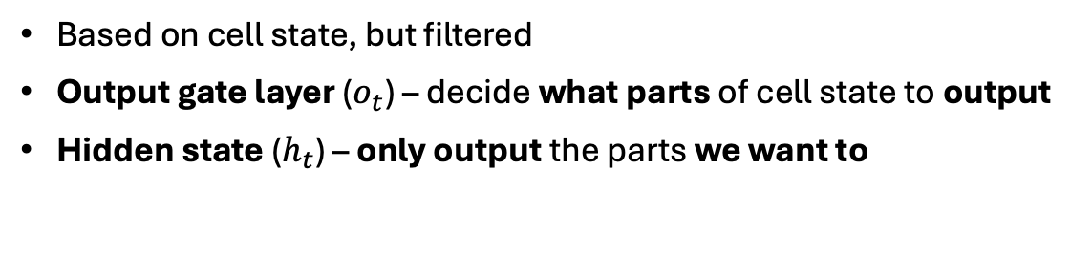
Long Short Term Memory (LSTM) – Output Gate
Step 4: Decide what information to output
Based on cell state, but filtered
Output gate layer ($o_{t}$) – decide what parts of cell state to output
Hidden state ($h_{t}$) – only output the parts we want to
Push cell state in [-1, 1]

Slide 27
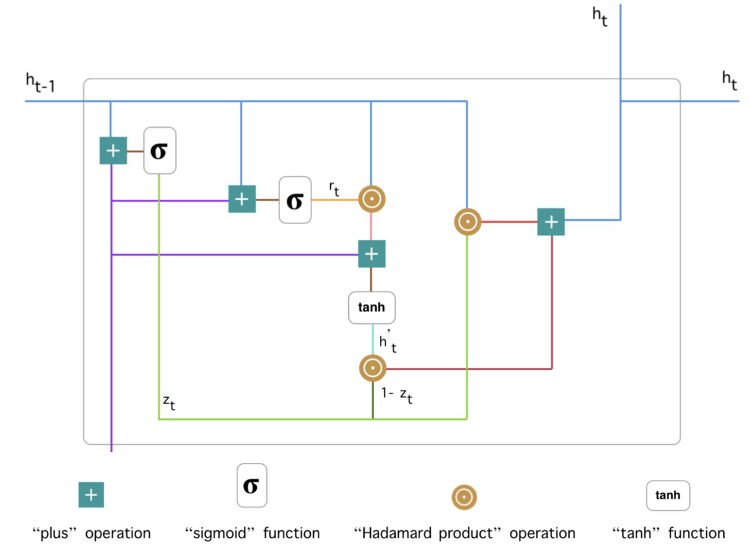
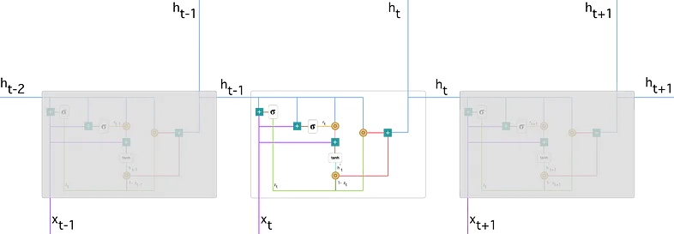
Gated Recurrent Unit (GRU)
Special case of LSTM
Combines forget and input gates into single “update gate”
Merges cell state and hidden state
Simpler than normal LSTM

Slide 28
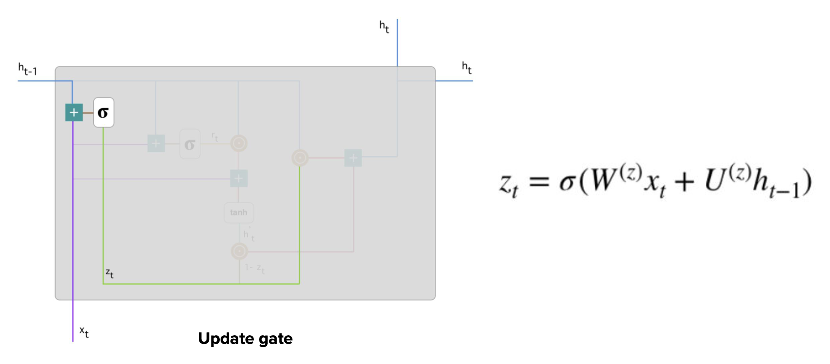
Gated Recurrent Unit (GRU) – Update Gate
Determines how much past information (from previous time steps) to pass over to future
Input at time t
Info for previous t-1 steps
Squash between
0 and 1

Slide 29
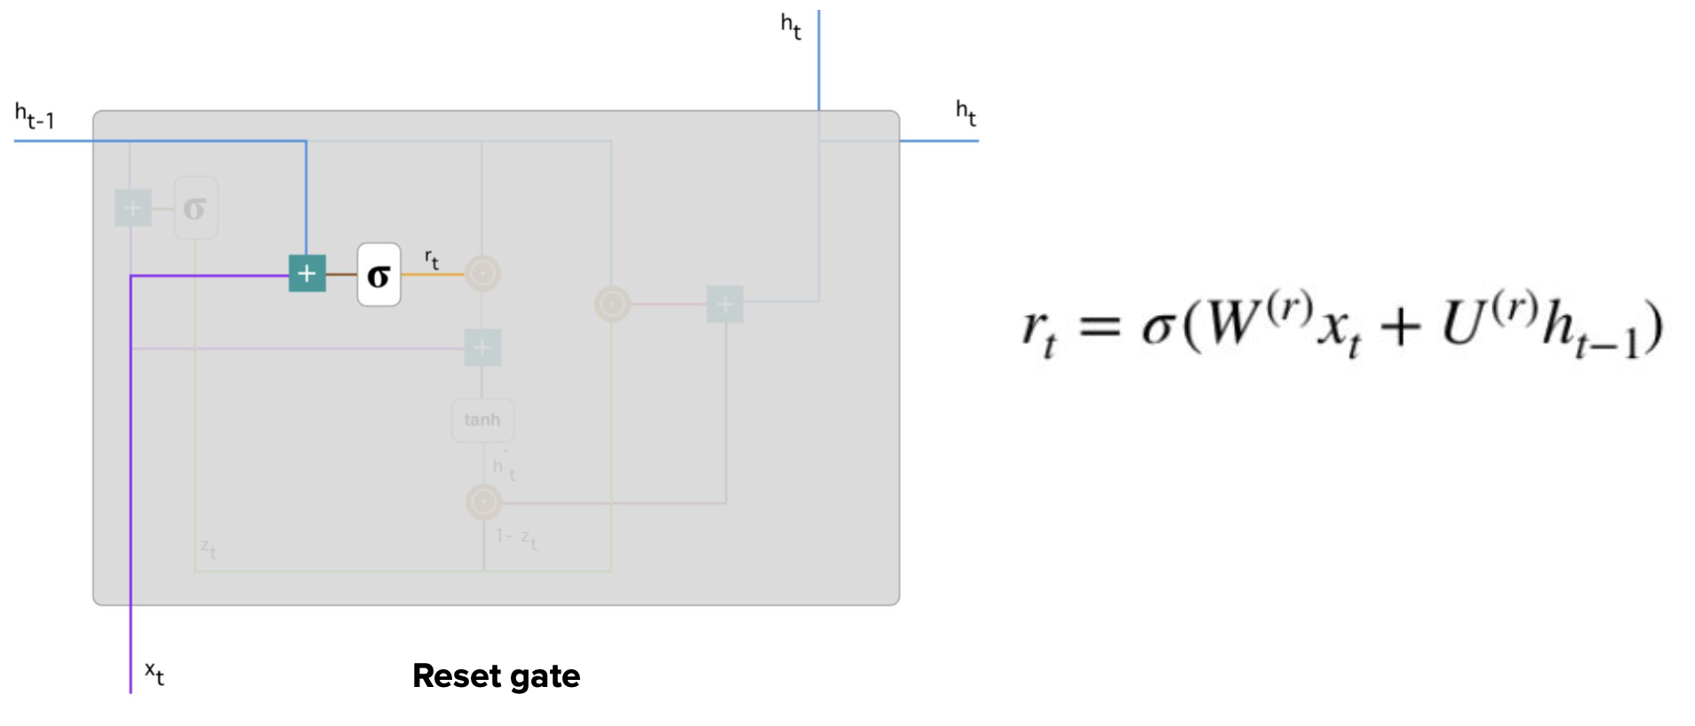
Gated Recurrent Unit (GRU) – Forget (Reset) Gate
Decide how much past information to forget
Same formula as the update gate, but different weights & usage (explained later)

Slide 30
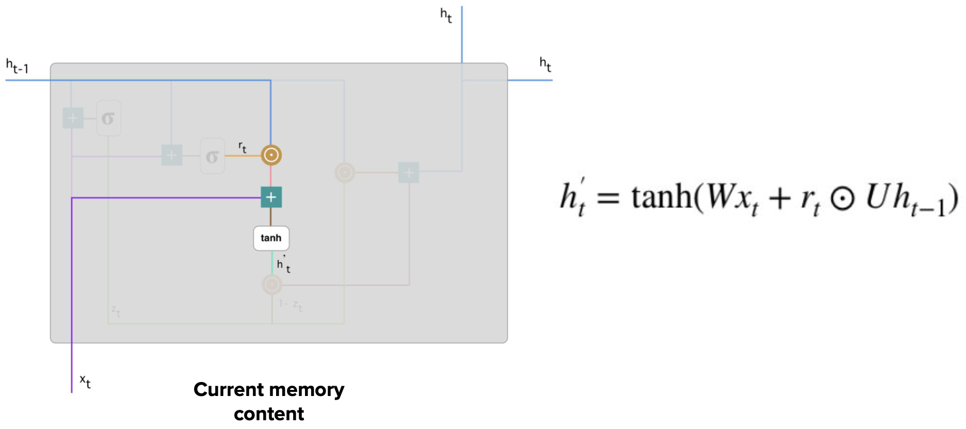
Gated Recurrent Unit (GRU) – Current Memory Content
New memory content – uses reset gate to store relevant information from past
New (current) information
Remove from previous time steps

Slide 31
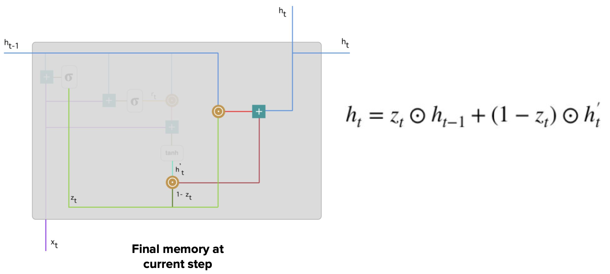
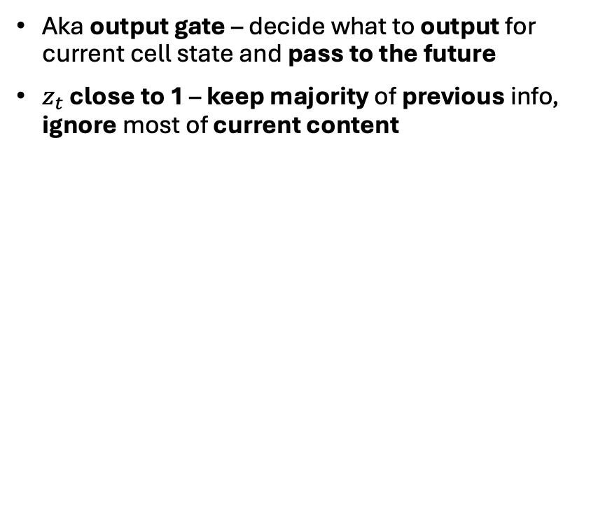
Gated Recurrent Unit (GRU) – Final Memory at Current Step
Aka output gate – decide what to output for current cell state and pass to the future
$z_{t}$ close to 1 – keep majority of previous info, ignore most of current content
Previous info
Current info

Slide 32
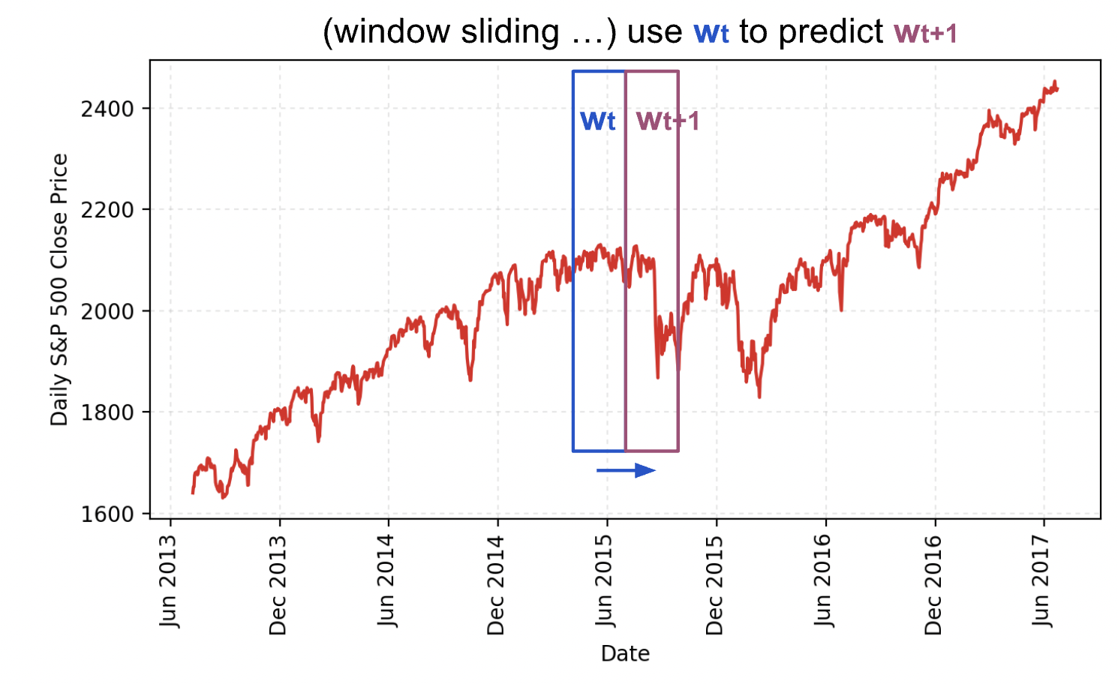
Effect of Larger Window or Features Size on Performance
Larger window size (num_steps):
More historical context (good for long-term dependencies)
More computational load (longer training, increased memory usage)
Potential overfitting
Stability: Vanishing/Exploding gradients
More features (input_size) per step:
Determines dimensionality of input data per time step
Increases model complexity

Slide 33
Part 2: Quantization

Slide 34
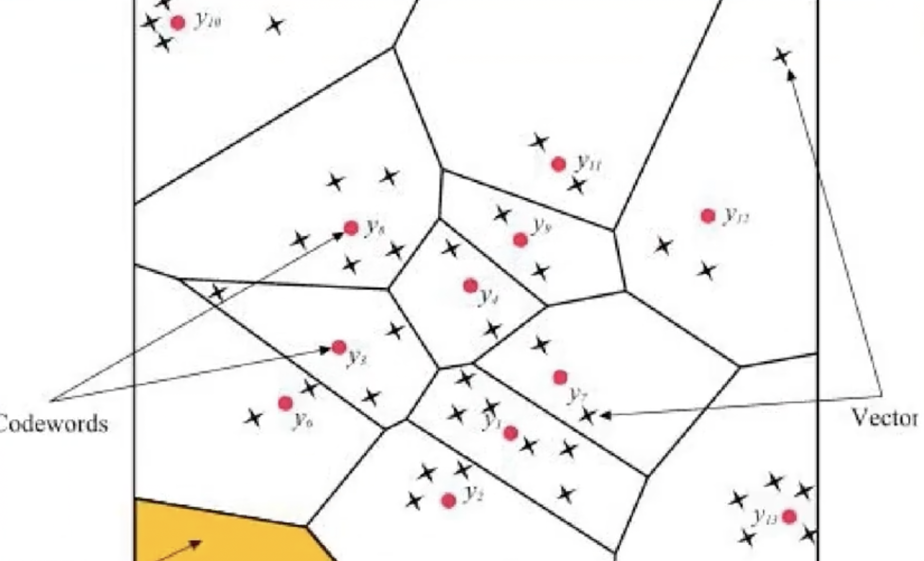
What is Quantization?
Approximate continuous values of signal into finite # of discrete values
Method of data compression (convert values into lower precision/range)
Fixation – linear quantization to base 2
Precision representations: FP16 (half-precision floating-point), INT8 (8-bit fixed-point integer), INT4 (8-bit fixed-point integer), etc.
Here, we convert FP32 numbers (floating-point) into INT8 (fixed-point)
Values separated into finite regions

Slide 35
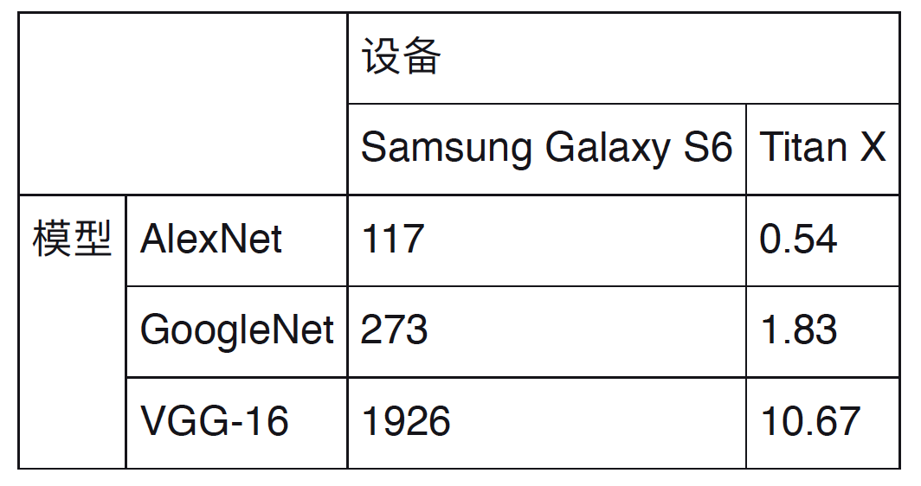
Why Quantization is Important
Network | Model (MB) | GFLOPS
AlexNet | 214 | 0.72
VGG-13 | 532 | 11.3
VGG-16 | 552 | 15.6
VGG-19 | 576 | 19.6
ResNet-50 | 102 | 41.2
ResNet-101 | 178 | 7.84
ResNet-152 | 240 | 23.1
GoogleNet | 27 | 1.6
InceptionV3 | 89 | 6
MobileNet | 38 | 0.58
SqueezeNet | 30 | 0.84
Deep learning frameworks (e.g., Tensorflow, Pytorch, etc.) use FP32 values for computation
Larger models → more computational + storage overhead → limits deployment on devices (e.g., smartphones, watches, FPGA, etc.)
Device
Model
Size & giga-floating point operations per second (GFLOPS)
Inference times of different models on different devices (ms)

Slide 36


Goal of Quantization
Smaller model size
Lower computational power
Less storage
Faster computation
Unbiased predictions
Memory usage and computational power consumption of different precisions

Slide 37

Theoretical Peak Performance
Theoretical peak performance – maximum performance given ideal conditions & perfect efficiency
$$\boxed{Theoretical Peak Performance=\left(\# of calculations per cycle\right) ∗Chip Frequency}$$
$\# of calculations per cycle$ – determined by chip architecture (e.g., single core performs 4 FLOPs per cycle)
$Chip Frequency$ – clock speed of the chip in Hz (e.g., 3B cycles per second, or 3B Hz)
Example: chip performs 4 calculations per cycle, operates at 3GHz
Peak performance = 4 calculations / cycle * 3G cycles / second = 12 GFLOPS
Want:
Maximum peak performance on deployed hardware
Minimum additional computation overhead

Slide 38
Quantization Methods with High Acceleration
Binary – reduce weights of NN into two values: -1 and 1
Drastically reduces memory & computational cost
Very aggressive quantization – significant accuracy loss
Used in binary neural networks (BNNs)
Linear – map continuous values to a finite set of equally spaced values (e.g., FP32 to INT8)
Symmetric - maps to range centered around 0, same scaling for (+) and (-) values
Asymmetric - range not centered around 0, different scaling for (+) and (-) values
Additional computation – standard vector operations (can be utilized via SIMD)
Supported on NVIDIA GPUs, x86, and ARM platforms, including TensorRT
Logarithmic – convert values into logarithmic scale
Multiplication to addition – reduces # of bits required for computationt
Rarely used - only used in few specialized chips

Slide 39
Linear Quantization
Maps a continuous range of values into finite set of equally spaced values
Can convert FP32 into INT8
Procedure:
Determine the range of data (min, max)
Linearly scale data to fit the range of integers
Perform inverse quantization during inference to recover floating-point values
Symmetric 8-bit (b=8) quantization range: [-128, 127]
Used in TensorRT

Slide 40





Linear Quantization
Quantization:
$S$– scale factor, $Z$ – center, $b$ - # of bits
Initial quantization: $S=\frac{max abs value}{2^{b−1}−1}$
Final quantization: $S$ found optimally (see Entropy Calibration)
Dequantization:
TensorRT: uses linear, symmetric, INT8 (b=8) quantization – range [-128, 127]
Symmetric:

Slide 41
Classification of Quantization Methods

Slide 42
When to Use Bias Term?
Layer | Bias Required? | Reason
Convolutional | Yes | Output of convolution operation
Fully-Connected | Yes | Output of matrix multiplication (dense layer)
LSTM | Yes | Used in gate calculations
GRU | Yes | Used in update and reset gate calculations
Batch normalization | No | Not used directly (learnable params like gamma, beta used)
Activation functions | No | Not applicable for ReLU, sigmoid, tanh

Slide 43

Kullback-Leibler (KL) Divergence
Given the actual distribution (p) and the model distributions (q):
Cross-entropy
Information loss
Measures relative entropy between two distributions
Used to reduce quantization error by adjusting distributions of activations or weights
Want to minimize KL(p || q)

Slide 44

Entropy Calibration via KL Divergence
Scale factor = threshold / 2^(b - 1)

Slide 45

Overall Quantization Procedure
Post-training (during inference) quantization:
0. Calibration – determine optimal scale factor (S) & zero-points (Z), using KL divergence
Collect activations – run original data through model (capture all layers to quantize)
Compute histogram + preliminary quantization (initial scale factor)
Compute KL divergence
Compute the optimal scale factor
Quantization - convert FP32 values into INT8 via linear, symmetric, 8-bit quantization
INT32 computations – convert into INT32 by performing y=Wx+b (including biases)
Requantization – reverse step 2 (back to INT8) for next layer
Dequantization in last layer – convert back to FP32？

Slide 46
References
RNN/LSTM/GRU:
https://stanford.edu/~shervine/teaching/cs-230/cheatsheet-recurrent-neural-networks
https://colah.github.io/posts/2015-08-Understanding-LSTMs/
RNN Stock Prediction:
https://github.com/jimenbian/stock-rnn
https://lilianweng.github.io/posts/2017-07-08-stock-rnn-part-1/
Model Quantification:
https://blog.csdn.net/Nichlson/article/details/121085747

Slide 47
Special Thanks
Special thanks to my advisor, Mr. Jialin Xing, and co-workers Mr. Jiyu Yang et al. for helping me throughout this internship

